Slide 1
Compliance to COA Requirements Subsidy Funded Projects

Slide 2
Memo to All ECs re Compliance to COA Audit Findings on Subsidy Funded Projects

Slide 3
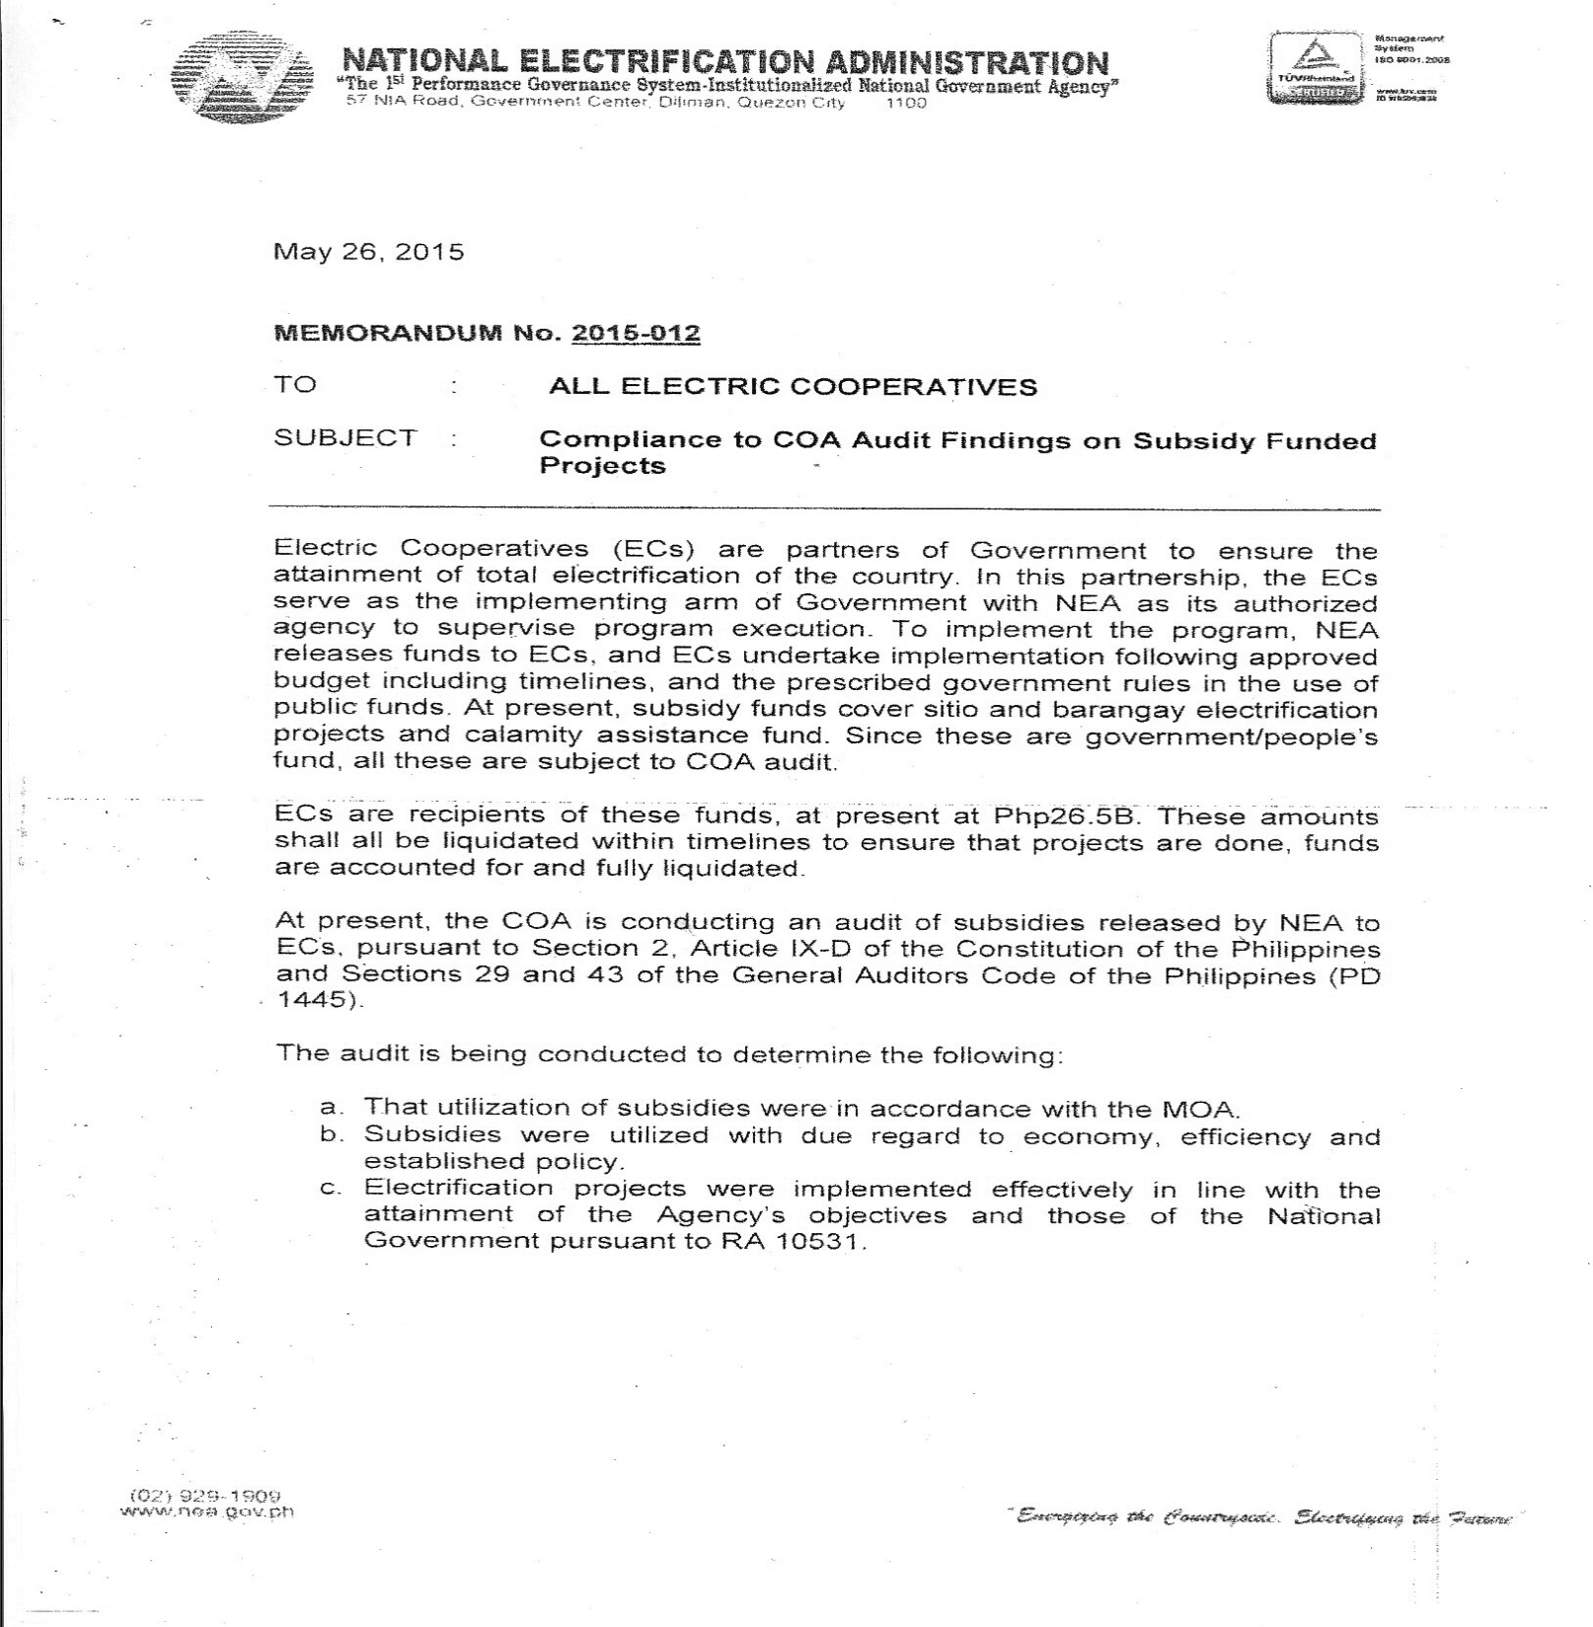
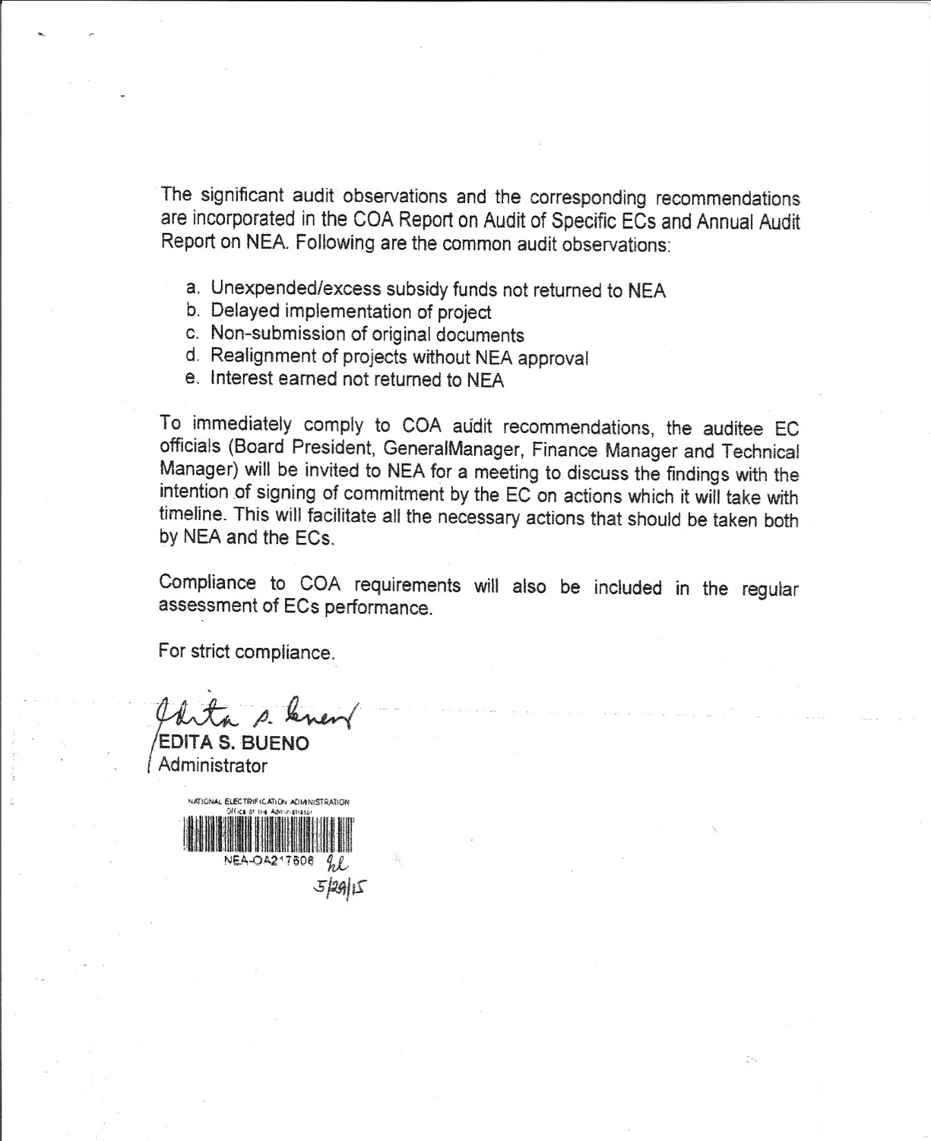

Slide 4
ECs are recipients of Php26.5B subsidy funds. These amounts shall all be liquidated within timelines to ensure that projects are done, funds are accounted for and fully liquidated.
COA is conducting an audit of subsidies released by NEA to ECs, pursuant to Section 2, Article IX-D of the Constitution of the Philippines and Sections 29 and 43 of the General Auditors Code of the Philippines (PD 1445).

Slide 5
The audit is being conducted to determine the following:
That utilization of subsidies were in accordance with the MOA.
Subsidies were utilized with due regard to economy, efficiency and established policy.
Electrification projects were implemented effectively in line with the attainment of the Agency’s objectives and those of the National Government pursuant to RA 10531.

Slide 6
The significant audit observations and the corresponding recommendations are incorporated in the COA Report on Audit of Specific ECs and Annual Audit Report on NEA.
Common audit observations:
Unexpended/excess subsidy funds not returned to NEA
Delayed implementation of project
Non-submission of original documents
Realignment of projects without NEA approval
Interest earned not returned to NEA
PKKV Implementation
Violation of some provisions in the RA 9184 in the Implementation of Subsidy Funded Projects

Slide 7
To immediately comply to COA audit recommendations, the auditee EC officials (Board President, General Manager, Finance Manager and Technical Manager) will be invited to NEA for a meeting to discuss the findings with the intention of signing of commitment by the EC on actions which it will take with timeline. This will facilitate all the necessary actions that should be taken both by NEA and the ECs.
Compliance to COA requirements will also be included in the regular assessment of ECs performance.

Slide 8
Template of Accounting of Funds (AOF)

Slide 9
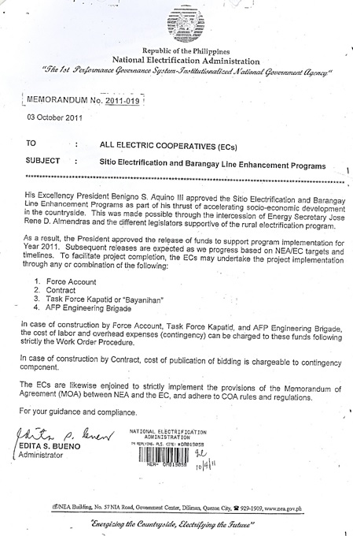

Slide 10
Allowable charges for Contingency Funds
1. From Memo to All ECs (2011-019 – 10/3/11)
- Cost of Publication of bidding
2. From Memo to IAQSMO (11 July 2013)
- A portion of salaries/benefits of EC’s regular employees assigned in the implementation of the project using WO
- Gasoline/fuel consumption
- Vehicle rental
- Transportation
- Meal allowance
- Subsistence allowance incurred during the implementation of the subsidy funds
*all these charges shall used Work order procedure

Slide 11
Thank you

Slide 12
I. Common COA Audit Observations
a. COA-AOM No. 2015-12 (2014)
EC |  | Unexpended Balance |  |  | EC |  | Unexpended Balance
 |  | Less than P100,000 | More than P100,000 | Interest Earned |  |  | Less than P100,000 | More than P100,000 | Interest Earned
1 | MASELCO | 85,364.43 | 11,213,280.18 | 457,551.90 | 10 | IFELCO | 52,651.47 | 567,795.84 | 109,064.94
2 | CEBECO III | 86,947.87 | 4,285,768.20 |  | 11 | PANELCO I |  | 1,054,893.17 | 98,264.35
3 | SORECO I | 97,501.44 | 4,039,093.85 | 147,514.89 | 12 | FICELCO |  | 5,300,978.86
4 | NEECO II-A2 | 476.19 | 2,679,340.63 | 109,675.62 | 13 | SURSECO I |  | 5,974,448.27
5 | LUELCO |  | 2,542,720.70 | 102,936.68 | 14 | PENELCO |  |  | 233,052.00
6 | TARELCO II | 7,351.07 | 1,434,042.26 |  | 15 | ZAMECO II |  |  | 49,460.95
7 | CEBECO II |  | 1,240,406.62 | 398,703.38 | 16 | MARELCO |  |  | 33,313.32
8 | BATANELCO |  | 1,144,997.50 | 234,590.81 | TOTAL |  | 330,292.47 | 42,562,079.61 | 1,974,128.84
9 | AKELCO |  | 1,084,313.53

Slide 13
a. Excess subsidy funds (NEA Memo No. 2013-022 dated September
a. Below P100,000 shall be returned to NEA 1 month after NEA Final Inspection and Acceptance
b. P100,000 and above can be realigned subject to NEA approval
Request for realignment should be submitted within 3 months from final inspection and acceptance.
In cases of approved realignment, the realigned subsidy funds shall undergo the same process as regular subsidy.

Slide 14
b. Timelines (Per MOA)
Project Implementation and Completion within 6 months after receipt of funds
Amendment
Should the Recipient foresee the possibility of failing to complete the project(s) within the six month period, it shall made a written request for extension thereof within thirty (30) days before its expiration. NEA shall act or the request for extension within the same 30 day period. Furthermore, any extension of the said six month period shall, in no case, exceed three (3) months.
Certificate of Final Inspection and Acceptance (CFIA) within 3` months from project completion
Close-out within 3 months from CFIA

Slide 15
EC |  | Unexpended Balance |  |  | Remarks
 |  | Less than P100,000 | More than P100,000 | Interest Earned
10 | IFELCO | 52,651.47 | 567,795.84 | 109,064.94
11 | PANELCO I |  | 1,054,893.17 | 98,264.35
12 | FICELCO |  | 5,300,978.86
13 | SURSECO I |  | 5,974,448.27
14 | PENELCO |  |  | 233,052.00
15 | ZAMECO II |  |  | 49,460.95
16 | MARELCO |  |  | 33,313.32
TOTAL |  | 330,292.47 | 42,562,079.61 | 1,974,128.84

Slide 16
c. Submission of original documents to support liquidation:
Accounting of Subsidy Fund on a per project basis
2. Disbursement Voucher supported by relevant documents
Straight Contract | By-Administration | Contract Labor/EC Materials
Contract | Payroll | Contract
- Accomplishment Report | PO | - Accomplishment Report
OR | RR | OR
- Abstract of Bids with Bid Documents | - Abstract of Bids with Bid Documents | - Abstract of Bids with Bid Documents
 | - MCrT and Summary of MCrT | - MCrT and Summary of MCrT
 | - MCT and Summary of MCT | - MCT and Summary of MCT
 | - Summary of fuel allocation/trip tickets

Slide 17
3. Staking Sheets (As-Built) for each project
4. Bill of Materials (As-Built) for each project
5. Certificate of Completion of Project
6. Bank Statements and/or passbook for all subsidies
7. Project Implementation Report

Slide 18
AOM No. 2015-13 (2014) – Audit of the PKKV Fund conducted in selected ECs disclosed the following deviations:
a. 605 consumers/beneficiaries were included as beneficiaries of the program but not qualified under item III.1.b of NEA Memo No. 2008-018 dated June 26, 2008;
b. 655 were disconnected on or before implementation date of the program;
c. 100 consumers/beneficiaries were granted subsidy of more than P500 charged to the subsidy fund; and
d. 316 identified consumer/beneficiaries who were not granted the P500 one time subsidy based on the ECs billing system

Slide 19
AOM No. 2015-14 (2014) – Implementation of the subsidy funded projects of some ECs violates provisions of the RA 9184
The advance payment or 30% mobilization fee paid by ECs to its contractors exceeds the limit of 15% prescribed under Section No. 4.1 and 4.2 of Annex “E” on Contract Implementation Guidelines for the Procurement of Infrastructure Projects of the Revised Implementing Rules and Regulations (IRR) of Republic Act (R.A.) 9184 or the Government Procurement Reform Act.
Failure of EC to require the winning bidders to post the required performance security
Accounts receivables of bidders were accommodated as bid security in lieu of cash bond
Absence of a contract between the EC and contractors
Inconsistencies on the dates of the bidding activities
Non-conformance of the members of the BAC on their assigned function
Setting monetary limit as to what procurement method to use
Inclusion of Simplified Bidding (Sealed Canvass) as an alternative mode of procurement

